Slide 1

Coronavirus Tweet Sentiment Analysis
Twitter is a rich source of data for the study of public opinion on current issues. Here we present the results of our analysis of tweets related to the coronavirus pandemic.
By- Vibhuti Gupta & Rudraashish Sen Gupta

Slide 2

Problem Description
This challenge asks us to build a classification model to predict the sentiment of COVID-19 tweets. The tweets have been pulled from Twitter and manual tagging has been done then.
The names and usernames have been given codes to avoid any privacy concerns. We are given the following information:
Location
Tweet At
Original Tweet
Label

Slide 3
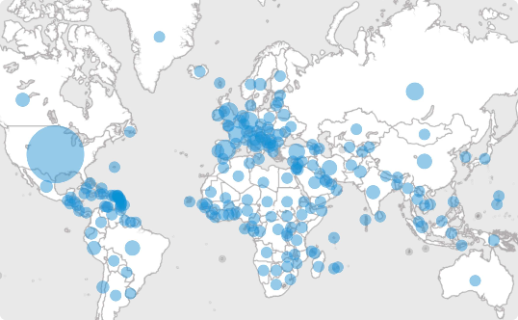
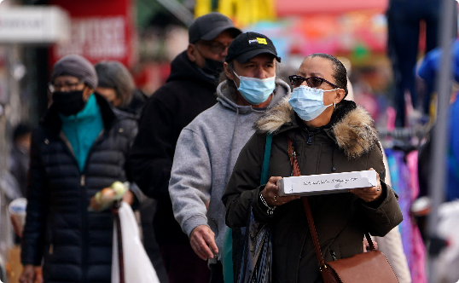

Why Analyze Coronavirus Tweets?
Impact
Behavior
Research
The pandemic has impacted all areas of life. Analyzing sentiment surrounding coronavirus can help to understand how people feel and react to the situation.
Sentiment analysis of tweets can provide insights into how people are behaving during the crisis. It can help authorities to make evidence-based decisions.
Sentiment analysis of tweets can help researchers and journalists understand people's perceptions and attitudes towards the virus, and how these evolve over time.

Slide 4
Data Summary
We are given the dataset having 6 columns –
UserName
Screenname
Location
TweetAt
OriginalTweet
Sentiment

Slide 5

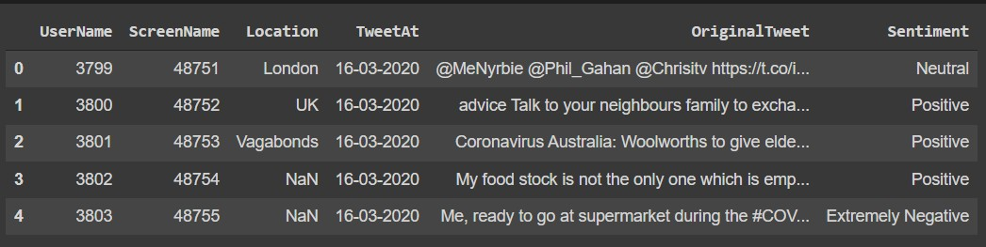
Importing Libraries & Data Inspection
Pandas – Manipulation of tabular data in Dataframes
Numpy – Mathematical operations on arrays
Matplotlib – Visualization
Seaborn – Visualization
Sklearn – Data Modeling
Nltk – Pre Processing / Feature Engineering
WordCloud – Visualization
Original Dataset contains 6 columns and 41157 rows.

Slide 6
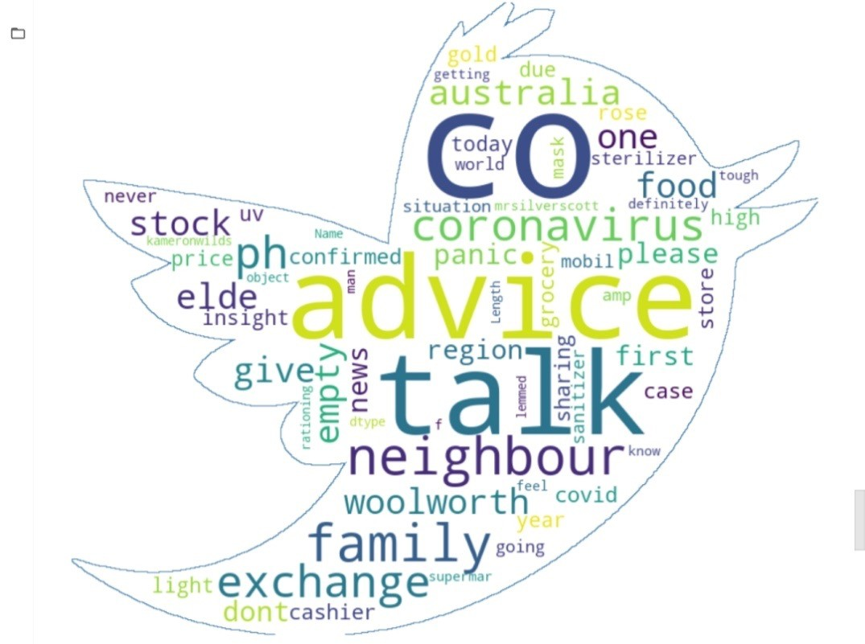
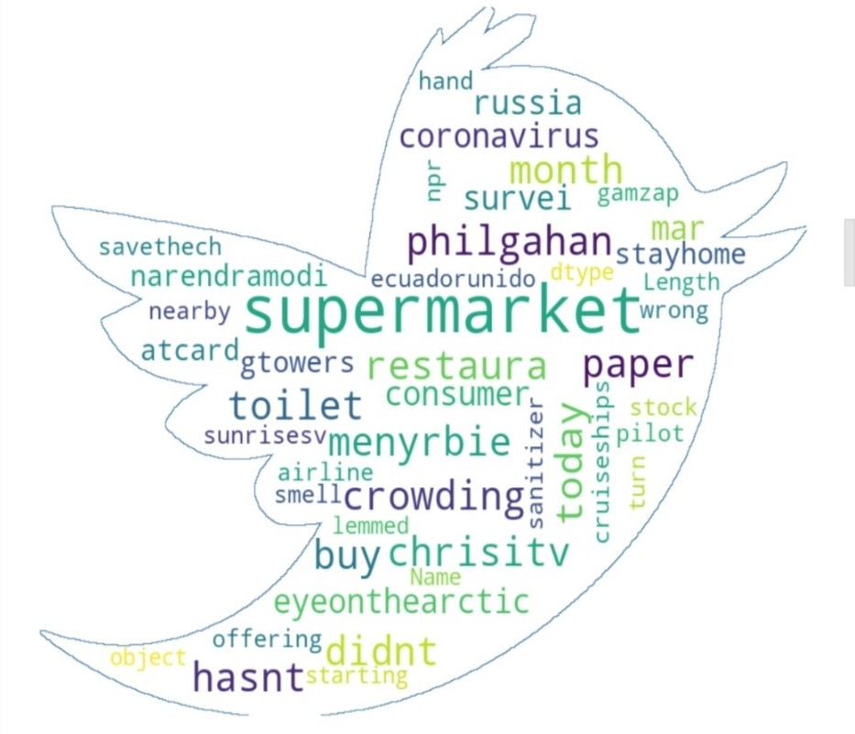
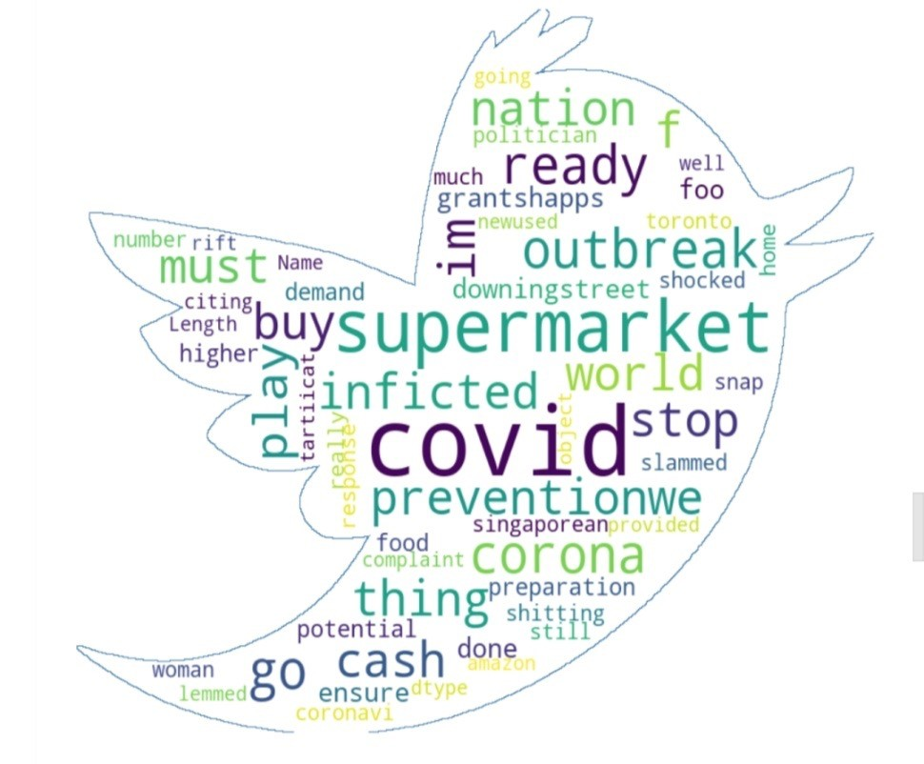
EDA Continued…
Word cloud
Word Clouds are visual displays of text data – simple text analysis. Word Clouds display the most prominent or frequent words in a body of text.
1. Positive Words
2. Neutral Words
3.Negative Words

Slide 7

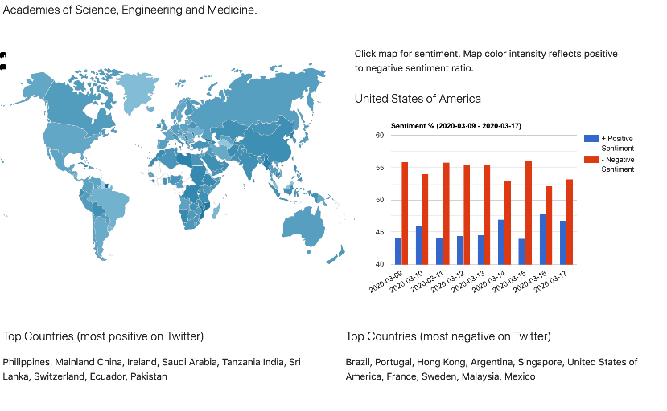
Results
Positivity Prevails
Some Negativity
Our analysis found that the majority of tweets about the coronavirus pandemic were positive, with people expressing support for health care workers and highlighting acts of kindness.
However, there were also negative tweets expressing frustration with government policies, misinformation, and the impact of the pandemic on mental health.

Slide 8
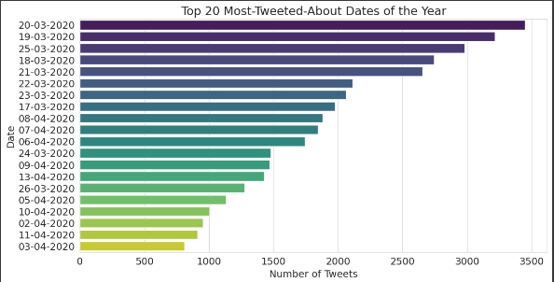
EDA Continued…
Top 20 Most Tweets About Date of Year

Slide 9
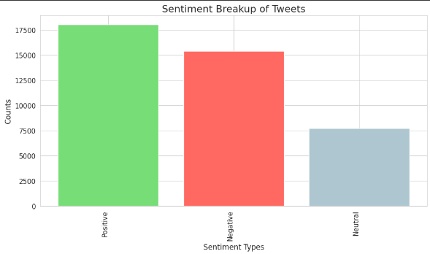
EDA Continued…
Sentiment Breakup Of Tweets

Slide 10
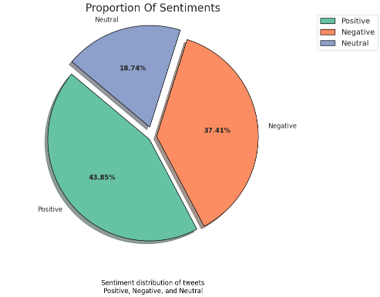
EDA Continued…
New Sentiments
As there was Sentiment,
five types of sentiments – Positive
Extremely Positive Sentiment, Negative
Sentiment, Extremely Negative Sentiment and Neutral Sentiment. So, we have replaced Extremely Positive Sentiment by Positive Sentiment and Extremely Negative Sentiment by Negative Sentiment. Now we have three types of sentiments – Positive Sentiment, Negative Sentiment and Neutral Sentiment.
The Pi Chart shows the proportion of each sentiment.
There are 43.85% Positive Sentiments,37.41% Negative Sentiments and 18.74% Neutral Sentiments.
Positive Sentiments are having higher proportion among all.

Slide 11
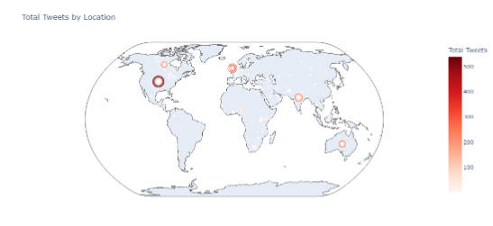
EDA Continued…
Total Tweets by Location

Slide 12
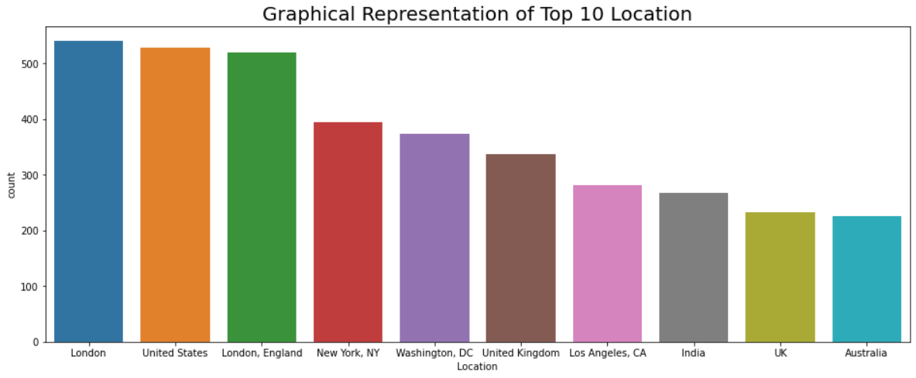
EDA Continued… Top 10 Locations
The above graph shows top 10 locations from where tweets are received. Most tweets received from London followed by United States.

Slide 13
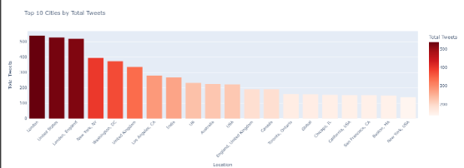
EDA Continued…
Top 10 Cities by Total Tweets
The above graph shows top 10 locations from where tweets are received. Most tweets received from London followed by United States.

Slide 14
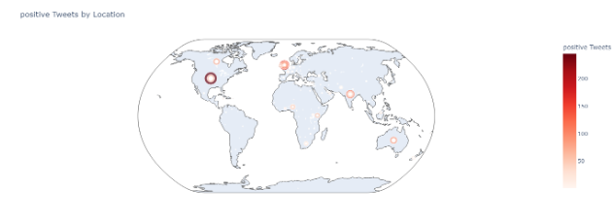
EDA Continued…
Positive Tweets by Locations

Slide 15
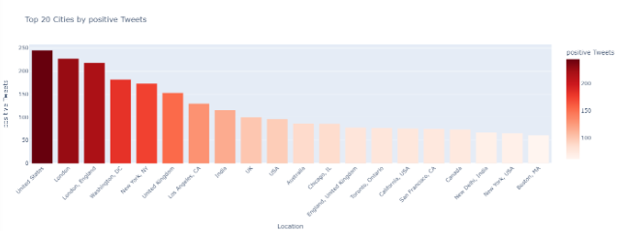
EDA Continued…
Top 20 Cities by Positive Tweets

Slide 16
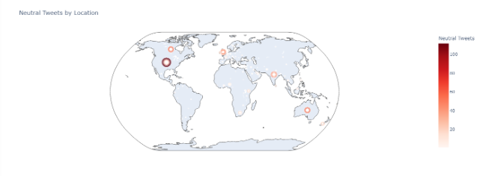
EDA Continued…
Neutral Tweets By Locations

Slide 17
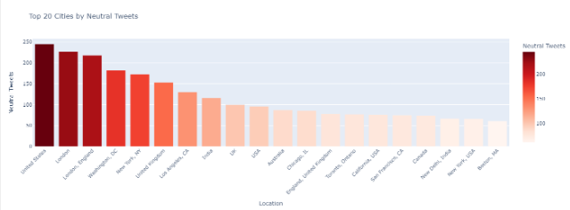
EDA Continued…
Top 20 Cities by Neutral Tweets

Slide 18
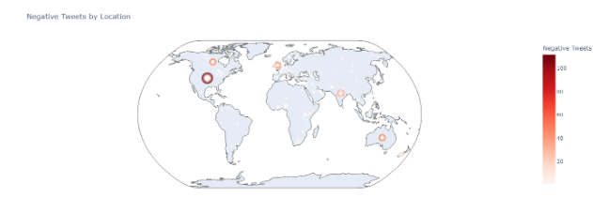
EDA Continued…
Negative Tweets by Locations

Slide 19
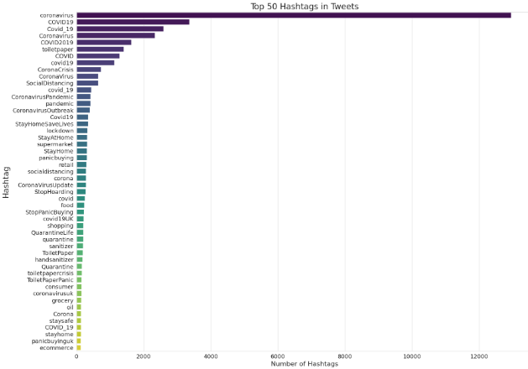
EDA Continued…

Slide 20
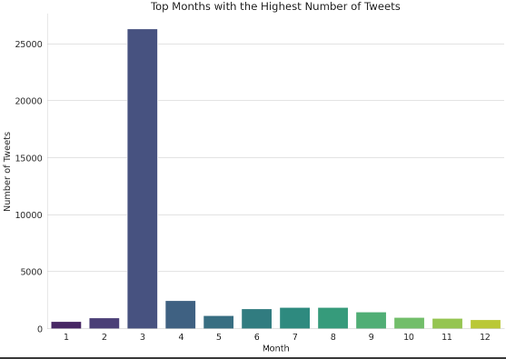
EDA Continued…

Slide 21
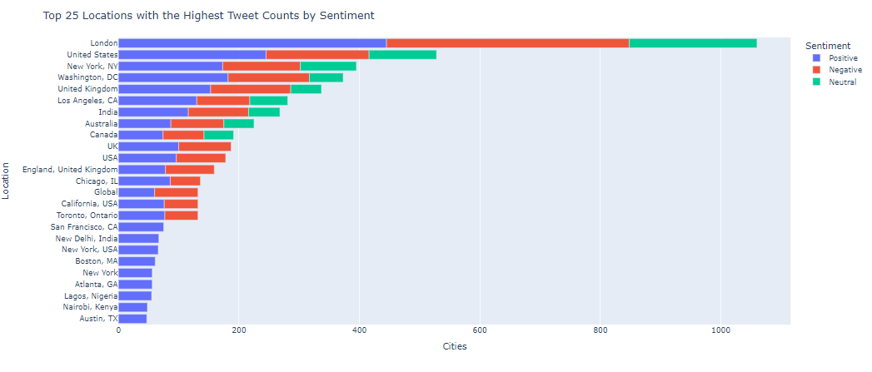
EDA Continued…

Slide 22
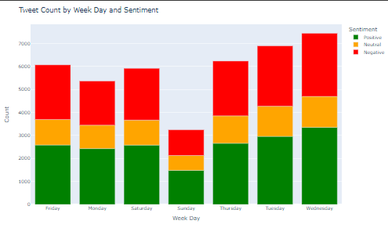
EDA Continued…

Slide 23
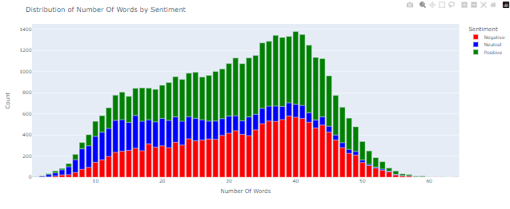
EDA Continued…

Slide 24
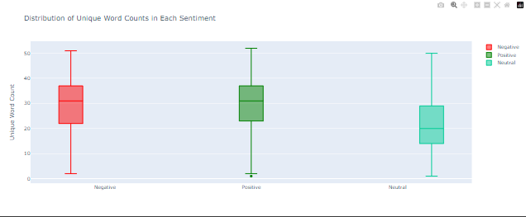
EDA Continued…

Slide 25
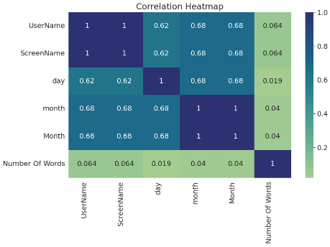
EDA Continued…

Slide 26
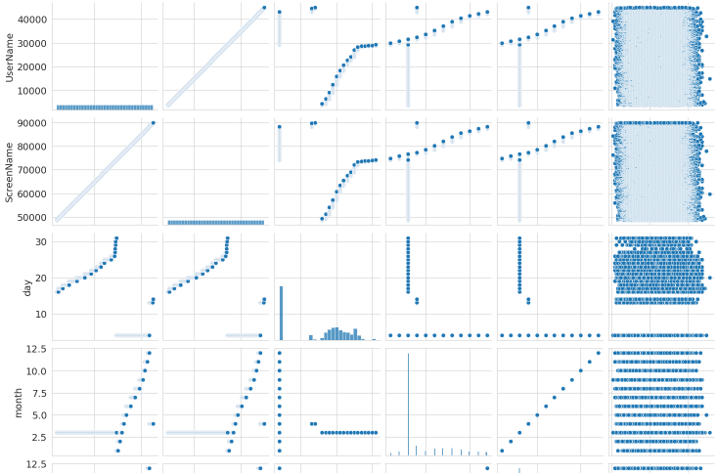
EDA Continued…
Pair Plot

Slide 27
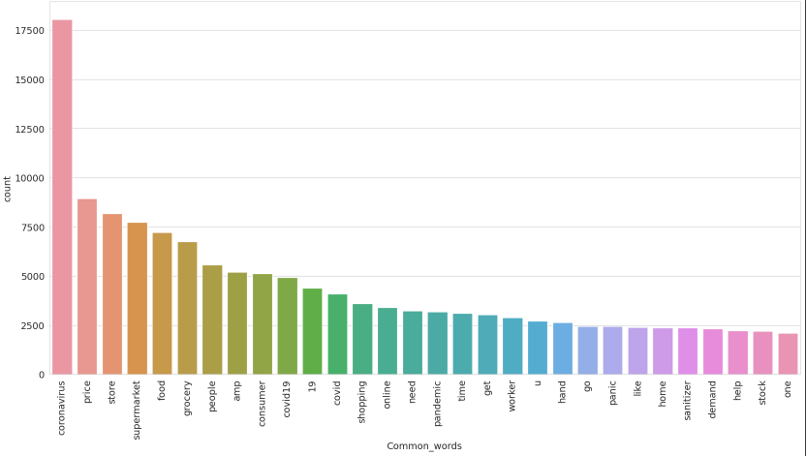
EDA Continued…
Common Words

Slide 28
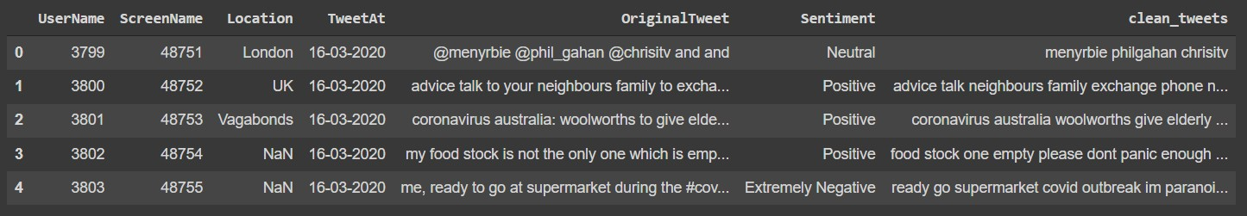
Feature Engineering
Step 1 : Converted all characters to lowercase. Step 2 : Removed Punctuation.
Step 3 : Removed stop words.
After dropping the null values and adding a new column ‘clean_tweets’, now we have 7 columns and 32567 rows.

Slide 29







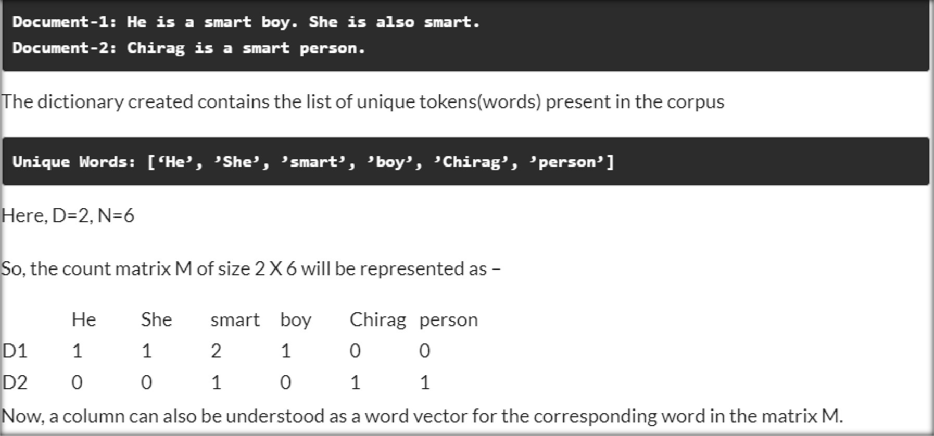
Model Preprocessing
Count Vectorizer - CountVectorizer is a great tool provided by the scikit-learn library in Python. It is used to transform a given text into a vector on the basis of the frequency (count) of each word that occurs in the entire text.

Slide 30








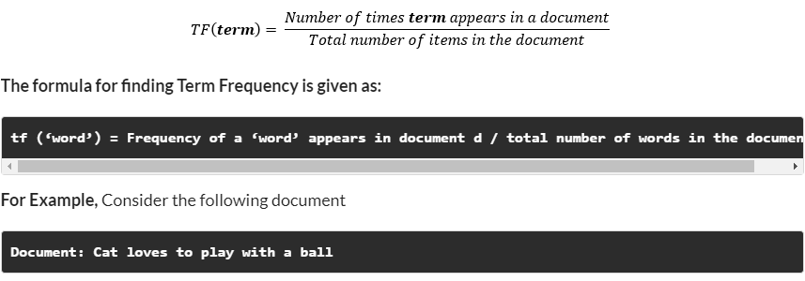
Model Preprocessing
TF-IDF -
Count Vectorizer method is simple and works well, but the problem with that is that it treats all
words equally. As a result, it cannot distinguish very common words or rare words. So, to solve this problem, TF-IDF comes into the picture! Term frequency-inverse document frequency ( TF-IDF) gives a measure that takes the importance of a word into consideration depending on how frequently it occurs in a document and a corpus.
Term frequency denotes the frequency of a word in a document.
It is the percentage of the number of times a word (x) occurs in a particular document (y) divided by the total number of words in that document

Slide 31
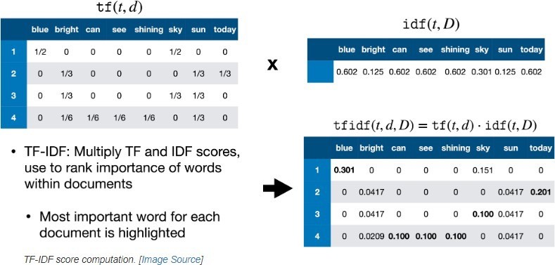
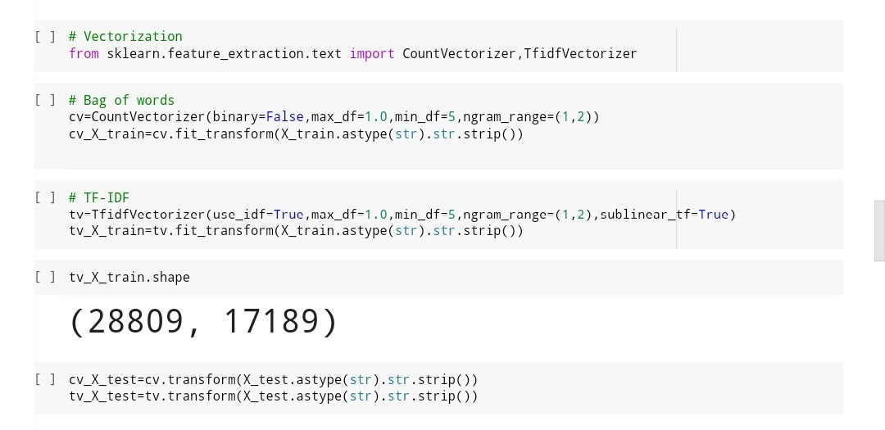
Model Preprocessing
Inverse Document Frequency - It measures the importance of the word in the corpus. It measures how common a particular word is across all the documents in the corpus.
It is the logarithmic ratio of no. of total documents to no. of a document with a particular word.
The difference in the TF-IDF method is that each cell doesn’t indicate the term frequency, but contains a weight value that signifies how important a word is for an individual text message or document

Slide 32
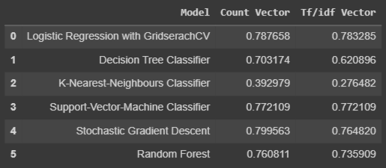
Model Training
Model Used
Logistic Regression with Grid Search CV
Decision Tree Classifier
KNN Classifier
SVM Classifier
Stochastics Classifer with GridsearchCV
Random Forest

Slide 33
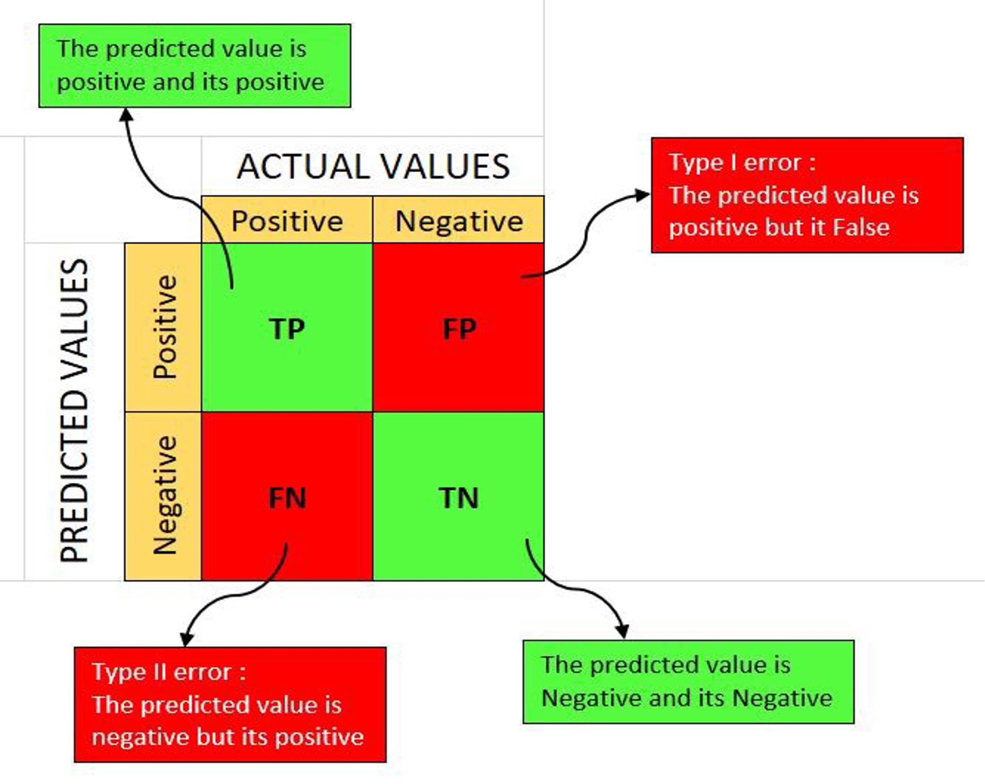
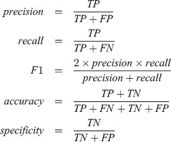

Performance metrics of classification models

Slide 34
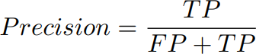
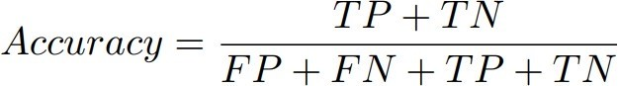
Precision Accuracy And Recall
Precision
Precision is the proportion of correct predictions among all predictions of a certain class. In other words, it is the proportion of true positives among all positive predictions.
Accuracy
Accuracy is the proportion of examples that were correctly classified. More precisely, it is sum of the number of true positives and true negatives, divided by the number of examples in the dataset.

Slide 35
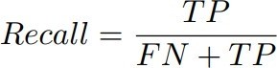
Precision Accuracy And Recall
Recall
Recall is the proportion of examples of a certain class that have been predicted by the model as belonging to that class. In other words, it is the proportion of true positives among all true examples.

Slide 36
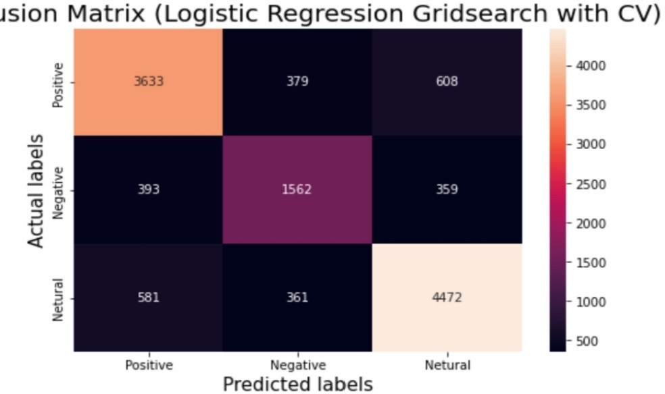
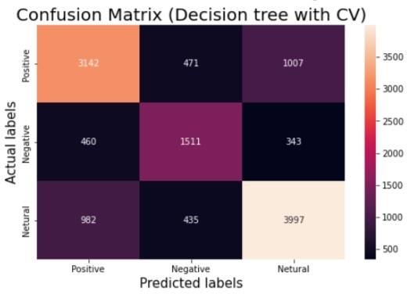
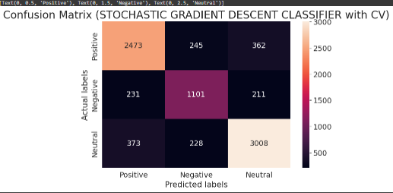
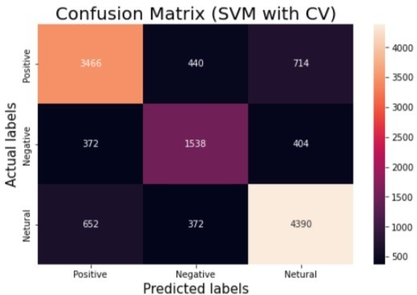
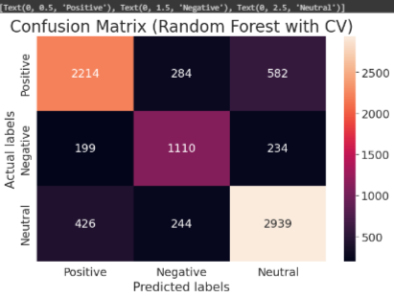
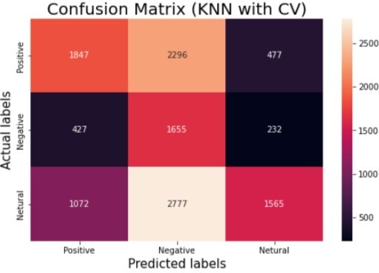
Confusion Matrix (count vector)
A Confusion matrix is an N x N matrix used for evaluating the performance of a classification model, where N is the number of target classes.

Slide 37
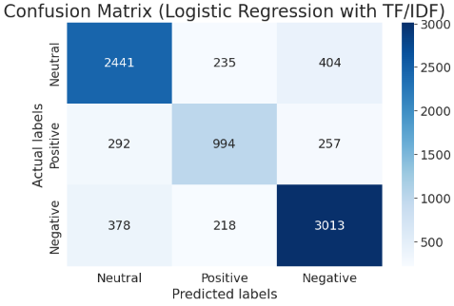
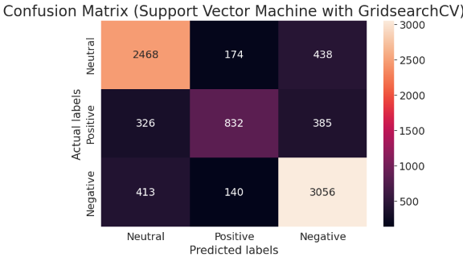
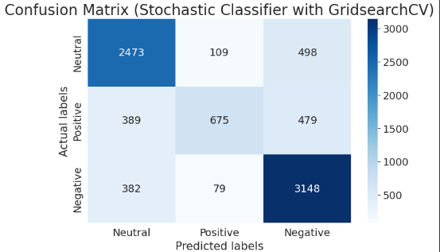
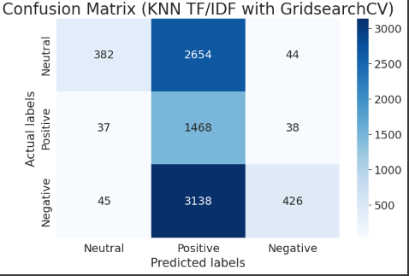
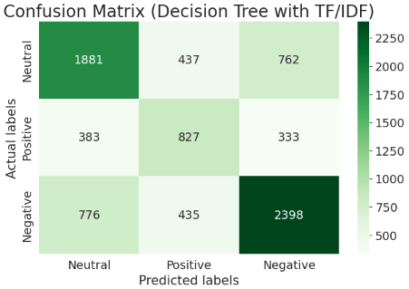
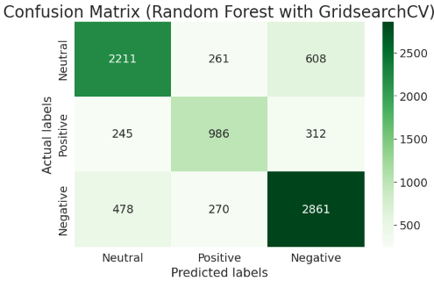
Confusion Matrix (TF-IDF Vector)

Slide 38
Implications & Future Research
Future Research
Future research could explore the impact of social media on public opinions and identify strategies for addressing misinformation and promoting accurate information.
1
2
3
Implications
Emerging Topics
The results of our analysis can inform public health communications and support government decision-making during the pandemic.
We are also interested in exploring the sentiment around emerging topics related to the pandemic such as vaccine hesitancy.

Slide 39
Conclusion
1
Positive Sentiment
2
Negative Sentiment
3
Potential Impacts
The majority of tweets about the coronavirus pandemic were positive.
However, there were also negative tweets expressing frustration with misinformation and the impact of the pandemic on mental health.
Our analysis has the potential to inform public health communication and government decision-making during the pandemic.

Slide 40


Thank You!!

